Slide 1
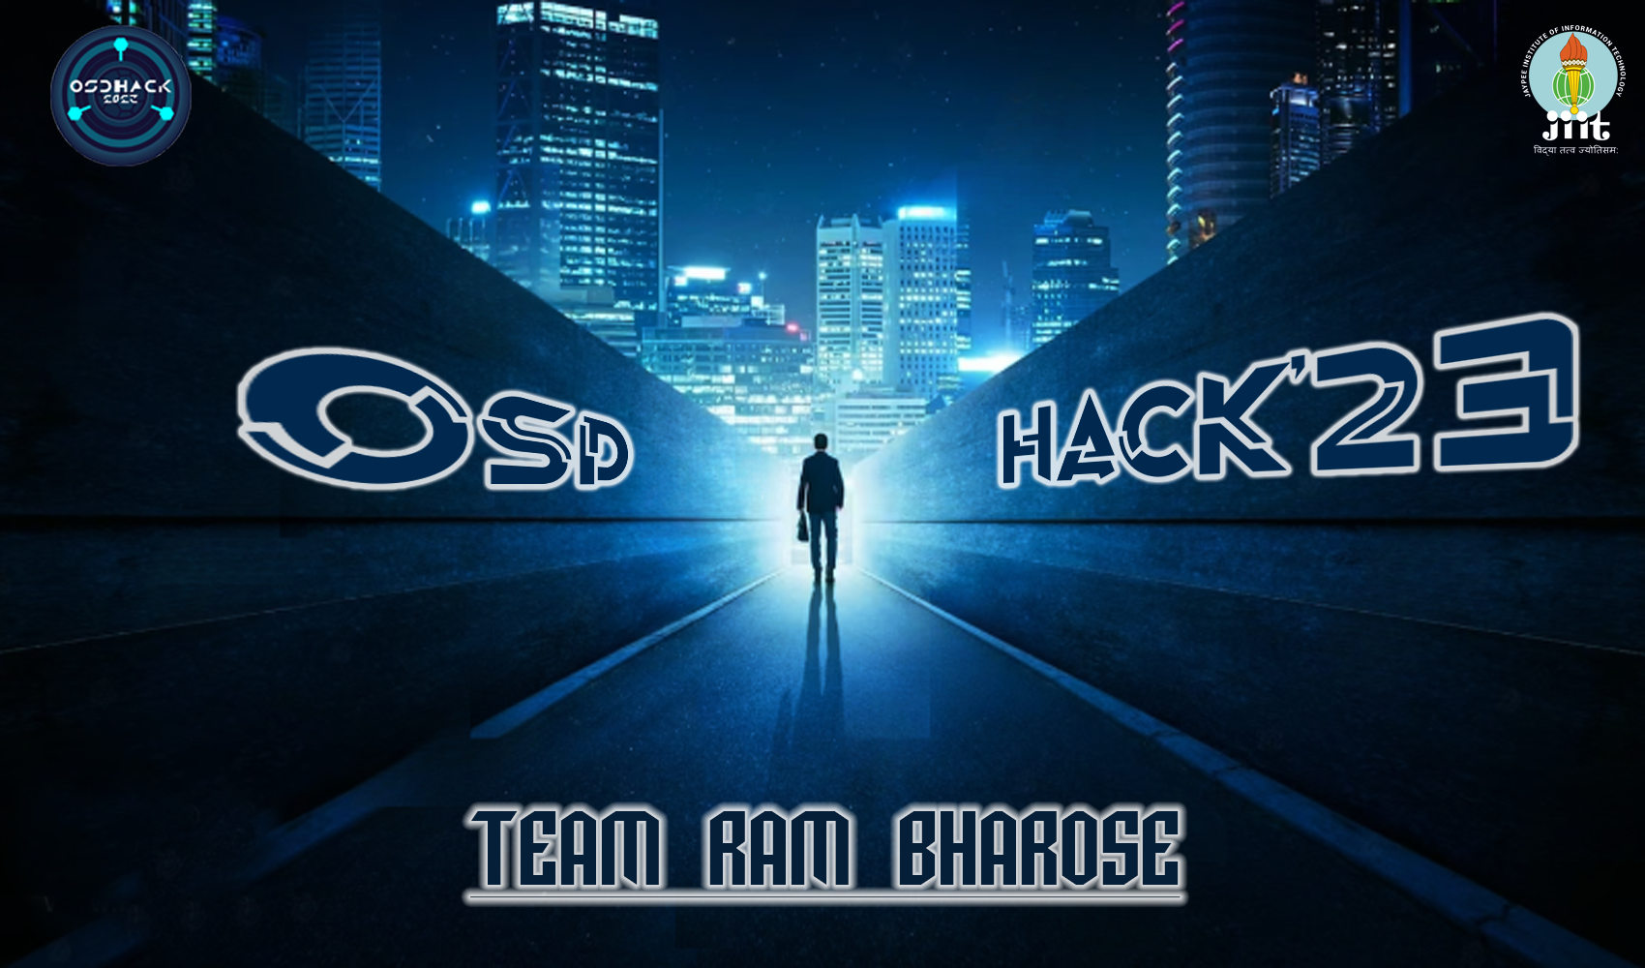

Slide 2
Project theme:
Back to the future

Slide 3
Project Title:
The Game :
DREAM VALLEY

Slide 4
Team Members:
1.Samyak Jain 21103075
2.Yashvi Sharma 21103071
3.Vivek Rao 21103059
4.Samay Thusoo 21103087
5.Aviral Rastogi 21103067
6.Vishrut Vardhan 21103079
Batch-B3

Slide 5
Overview
The DREAM VALLEY,
This game is based on a dream, chaman a normal boy who dreamt of being a samurai but is not able to be one, so this dream of his haunts him day and night. This game is based on his dream as the name suggest, in this chaman sleeps in his bed and while he is sleeping he dreams that he is a samurai and he starts his adventure in a world created by his own imagination, and he fights against opponents and fulfils his dream.

Slide 6
01
02
03
2D GAME
BASED ON SIMPLE CODING
INGAME ADVENTURE

